Slide 1

Continuous integration of a Timetracking application
Team members. Matrik.nr. Roles
Venkata Valluri V Ikram Ul Haq | 217197 209372 | Software Engineer Software Engineer
P. Bala Krishna M. Gokul | 210049 206744 | Test engineer Operations Engineer
17.08.2016
1

Slide 2
Content
Configuration with Puppet
Continuous integration & continuous delivery
Jenkins
Maven with selenium
Mockito
17.08.2016
1

Slide 3
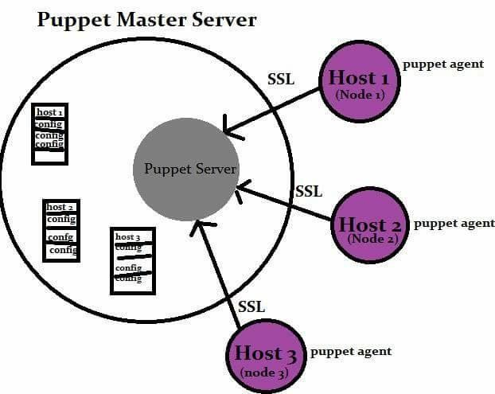
Configuration of server with Puppet
Puppet– An automation tool aid to configure a central server.
Master less puppet environment
manifests and modules distributed to machines
Ubuntu 14.04 is virtual private server.
17.08.2016
1

Slide 4
Configuration server with Puppet/2
Downloaded and installed puppet for Ubuntu 14.04
Commands for installation
# wget http://apt.puppetlabs.com/puppetlabs-release-trusty.deb
# dpkg –I /tmp/puppetlabs-release-trusty.deb
A puppet manifest decides the puppet work structure.
Manifests consists of following resource declarations Exec, Package, Service, File.
17.08.2016
1

Slide 5
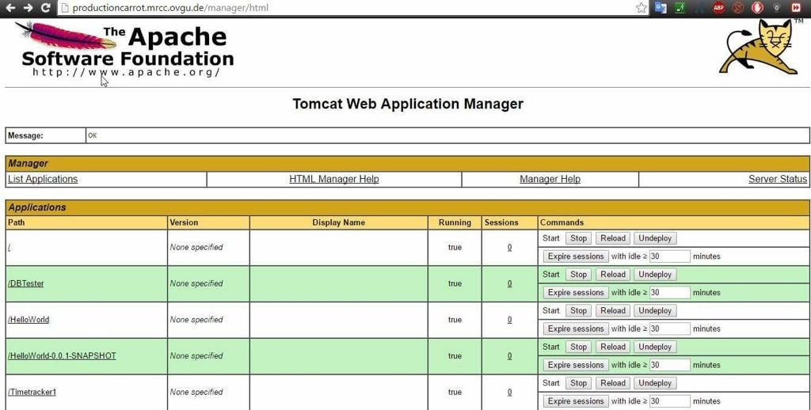
Configuration server with Puppet/3
Apache & tomcat provisioned to the server .
Init.pp file and site.pp are the main manifests.
Cnames of the server are
productioncarrot.mrcc.ovgu.de testingcarrot.mrcc.ovgu.de
17.08.2016
1

Slide 6
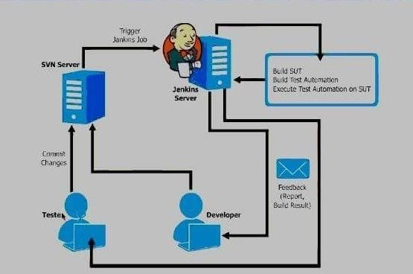
Continuous integration & continuous deployment
Merging all developer working copies into a shared repository
Fast development process
17.08.2016
1

Slide 7
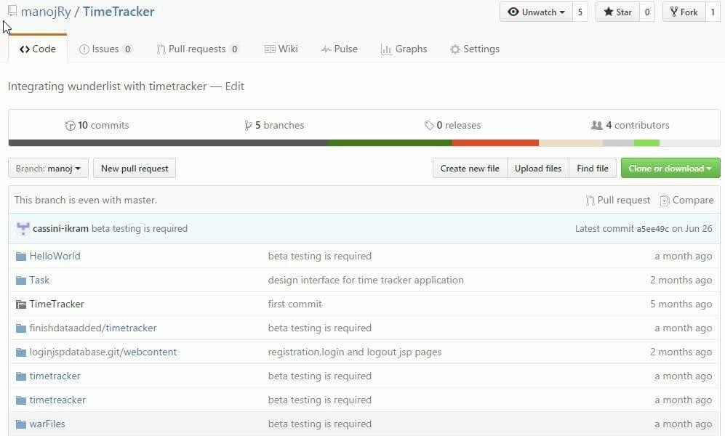
Git hub
GitHub as the shared repository for developers
Source code is pulled in Jenkins after developer commit
17.08.2016
1

Slide 8
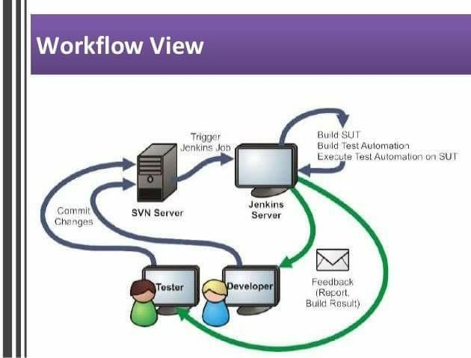
Jenkins
Open source continuous integration tool
Can perform unit test, integration test, determine build status ….
Developers will receive a feedback of their build
17.08.2016
1

Slide 9
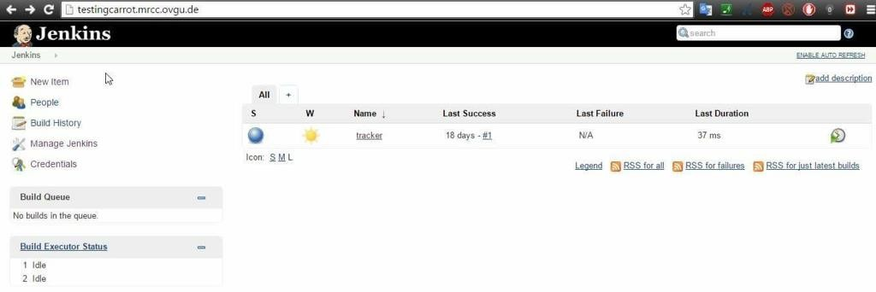
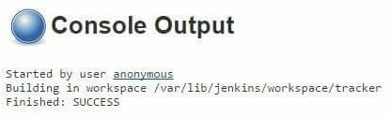
Jenkins/2
Jenkins setup on testingcarrot.mrcc.ovgu.de
17.08.2016
1

Slide 10
Jenkins/3
Installed Jenkins on Ubuntu 14.04 through repository
Installation commands of Jenkins
# wget –q –o –https://Jenkins-ci.org/debain/jenkins-ci.org.key|sudo apt –key –add
# sh –e 'echo deb http://pkg.jenkins-ci.org/debainbinary />/etc/apt/sources.list.d/jenkins.list #apt –get install jenkins
Puppet run is performed after installing Jenkins
17.08.2016
1

Slide 11
Time Tracking Application Synchronized with wunderlit.com

Slide 12
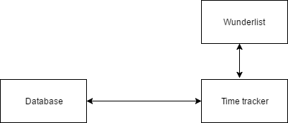
Basic Architecture
1

Slide 13
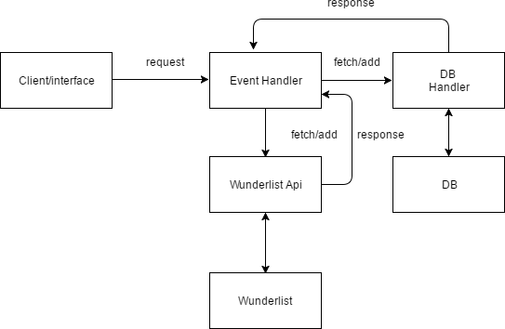
Request Processing
1

Slide 14
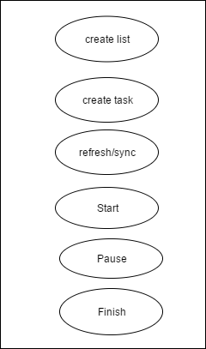
Operations
1

Slide 15
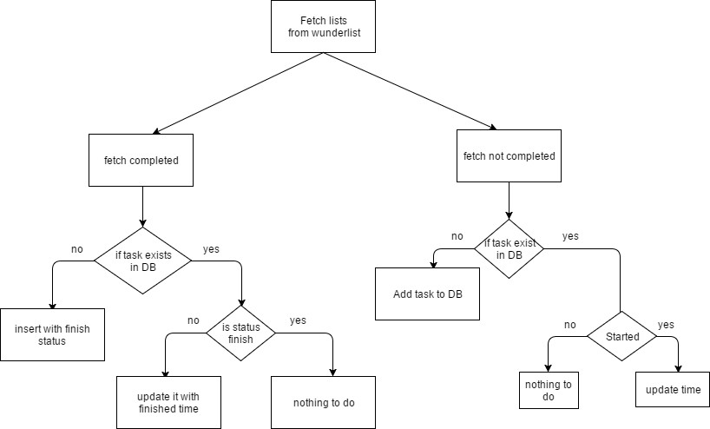
Loading/Refresh
1

Slide 16
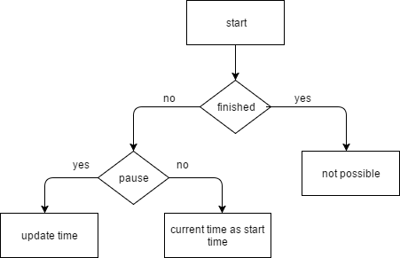
Start Task
1

Slide 17
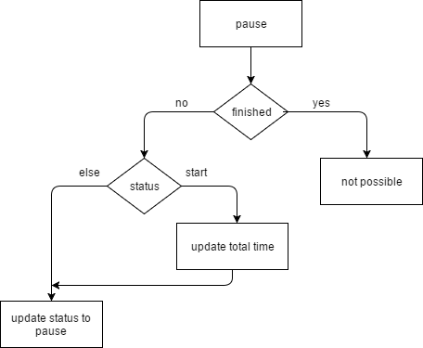
Pause Task
1

Slide 18

Finish Task
1

Slide 19
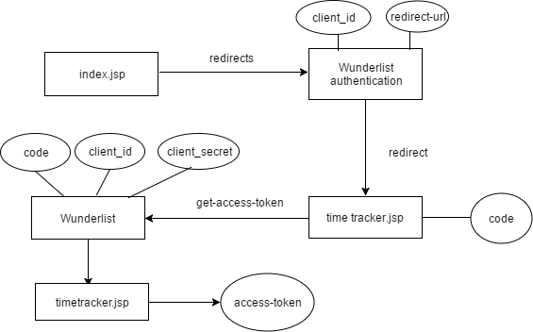
Uniquely identifying user
1

Slide 20
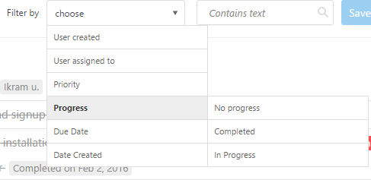
Scrum
Scrum roles
Team members
Scrum Master
Product Owner
Scrum board
https://freedcamp.com
Scrum methodology
Biweekly sprints
Scrum board
1

Slide 21
Black Box Testing
Functionality testing without taking the actual implementation in concern
Focuses on the outputs in response to selected inputs and execution conditions
This program is considered as a "black box"
17.08.2016
1

Slide 22
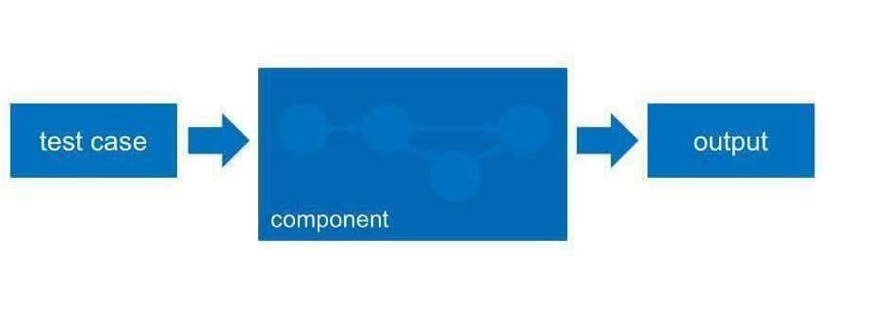
Black Box/2
Is conducted to evaluate the compliance of a system or application with specified functional requirements
The design and structure of the code is not known to the tester
17.08.2016
1

Slide 23
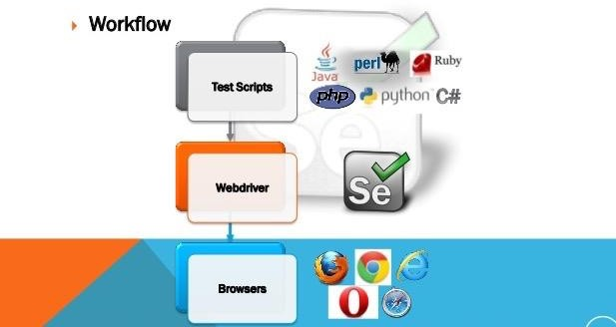
Tools for Black Box
Selenium:
Selenium is an open source automated testing suite for web applications
Selenium web driver is used to check the actual functional flow of time tracker application.
17.08.2016
1

Slide 24
Test cases
Sets of test inputs,execution conditions and expected results developed for a particular functional requirement
Identify test cases and identify the conditions that will cause it to execute
17.08.2016
1

Slide 25
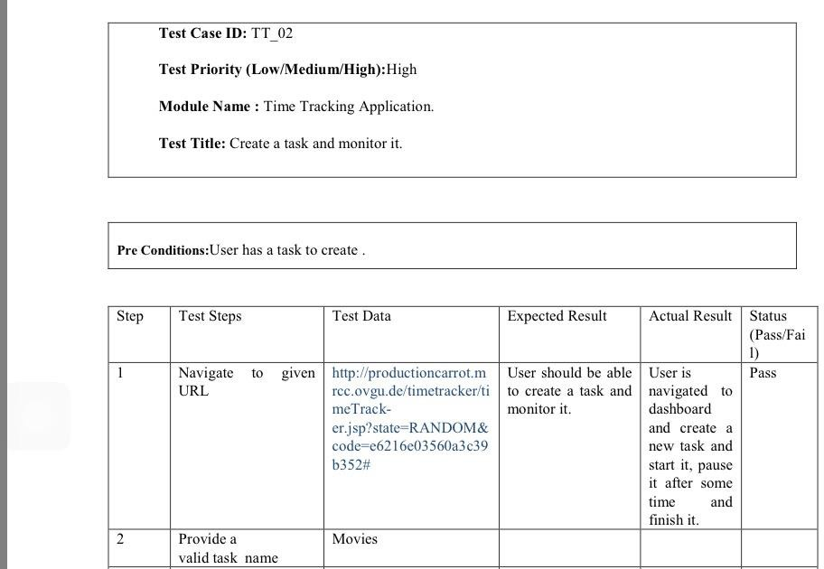
Test cases/2
17.08.2016
1

Slide 26
Maven
Building management tool that allows a developer to comprehend the complete state of a development effort in the shortest
period of time.
Areas of concerns:
Making the build process easy .
Providing a uniform build system.
Providing quality project information.
Providing guidelines for best practices development.
17.08.2016
1

Slide 27
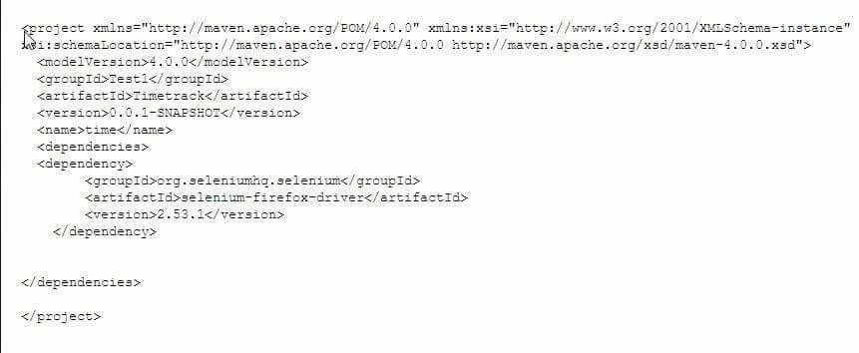
Maven in selenium
Helps to manage our selenium project's build easily
Create right project structure and manage .jar files in project build path
17.08.2016
1

Slide 28

Mockito
Why?
A unit test should test a class in isolation. Side effects from other classes or the system should be eliminated if possible.
To eliminate these side effects you have to replace dependencies to other classes. This can be done using replacements for the real dependencies.
How?
A dummy object is passed around
Fake objects have working implementations, but are usually simplified. For example, they use an in memory database and not a real database.
A stub class is an partial implementation for an interface or class with the purpose of using an instance of this stub class during
testing. Stubs may also record information about calls
A mock object is a dummy implementation for an interface or a class in which you define the output of certain method calls
What?
Mockito is a popular mock framework which can be used in conjunction with JUnit. Mockito allows you to create and
configure mock objects.
Using Mockito simplifies the development of tests for classes with external dependencies significantly.
17.08.2016
1

Slide 29
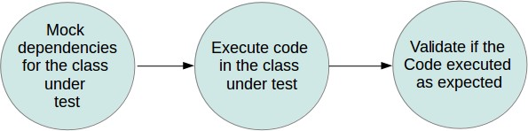
Mockito(2)
If we use Mockito in tests you typically:
Mock away external dependencies and insert the mocks into the code under test
Execute the code under test
Validate that the code executed correctly
17.08.2016
1

Slide 30
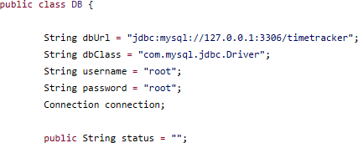
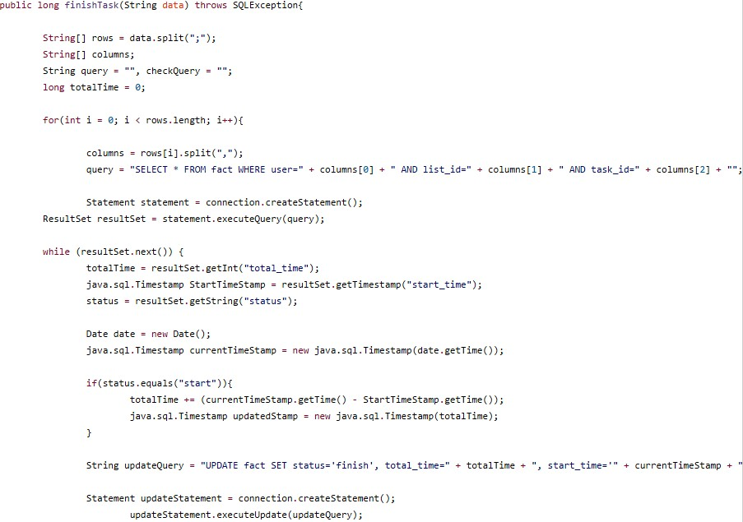
Mockito(3)
17.08.2016
1- The class for which we aim to generate tests
30

Slide 31
Mockito(4)
From (1)
We desire to generate tests for finishtask method. As such we have to make the interactions with the external database deterministic
As the database is interacted with through the Connection, Statement, Query, ResultSet,Updatestatement
,Totaltimeinterfaces (Figure 1), to abstract it away we must mock these interfaces , and ensure that the finishtask dependencies are replaced with the mock objects.
These mock objects are configured with a sequence of expected interactions and what it should respond for each of these interactions. They also record actual interactions locally, and can provide verification that specific interactions took place as expected after the method is run.
17.08.2016
31

Slide 32
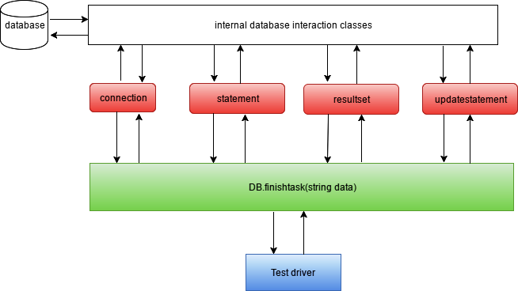



Diagrammatic representation
A
B
Object A interact with objectB
Object is class under test
Object is mocked
Object manages the test
A
B
Mock A does not interact with object B,but generally it does
17.08.2016
Object interaction and mocks necessary to abstract the database from DB.finishtask(string data)
32

Slide 33
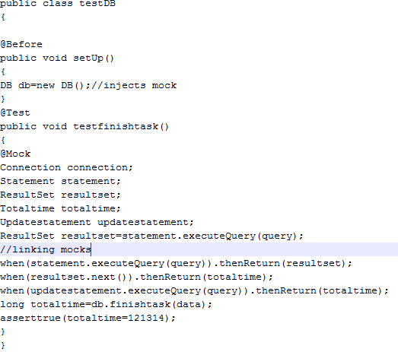
Generated test case
Generated test case
17.08.2016
1

Slide 34
Benefits of Mocking
Create tests in advance
Teams can work parallel
Create demos
Write test for resource which is not accessible
Isolate systems
17.08.2016
1

Slide 35
References
http://www.slashroot.in/sites/default/files/Working%20of%20Puppet%20Configuration%20Mangement%20tool.png
http://images.google.de/imgres?imgurl=http%3A%2F%2Fimage.slidesharecdn.com%2Fdevops-150627065118-lva1-app6892%2F95%2Fcontinuous-integration- with-jenkins-29-638.jpg%253Fcb%253D1435394546&imgrefurl=http%3A%2F%2Fwww.slideshare.net%2FEdurekaIN%2Fdevops- 49899456&h=359&w=638&tbnid=1sG5xi301VmWqM%3A&docid=kC3vAWKJv7ajEM&ei=PqazV6ayLMyXgAaPlbeICg&tbm=isch&iact=rc&uact=3&dur=408&page=2 &start=16&ndsp=24&ved=0ahUKEwimycrbj8fOAhXMC8AKHY_KDaEQMwhaKB0wHQ&bih=677&biw=136
17.08.2016
1

Slide 36
THANK YOU
36

